Slide 1



DEEP LEARNING S2DS @ Westminster University
Tim Scarfe, Ph.D
Principal Software Engineer @ Microsoft
Commercial Software Engineering (CSE)
@ecsquendor
youtube.com/machinelearningatmicrosoft
MACHINE LEARNING @ MICROSOFT
Notes:
We are hiring
Talk about CSE
Follow me on Twitter and machine learning at Microsoft youtube channel

Slide 2
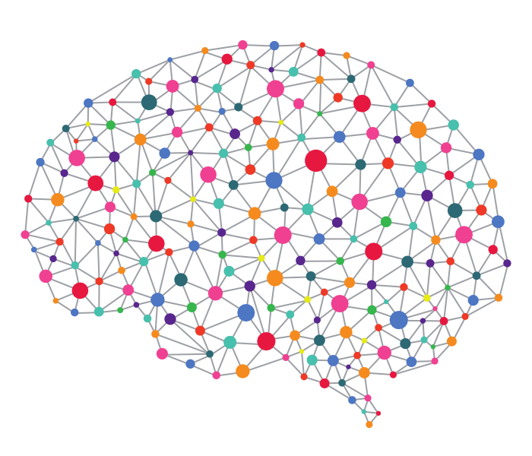

Talk outline
Deep learning intro
Distilled concepts of deep learning + Demo
CNNs + Demo
Sequence processing/NLP + Demo
Confused.com machine learning story
Questions
Notes:
If you know about basic deep learning and RNNs etc then this is probably going to be too basic for you
Lost;
Universal machine learning process

Slide 3


Francois Chollet is a living legend, please buy his book
https://www.manning.com/books/deep-learning-with-python
Notes:
Not a single mathematical formula
Francois is one of the best guys in the community right now
Show book

Slide 4
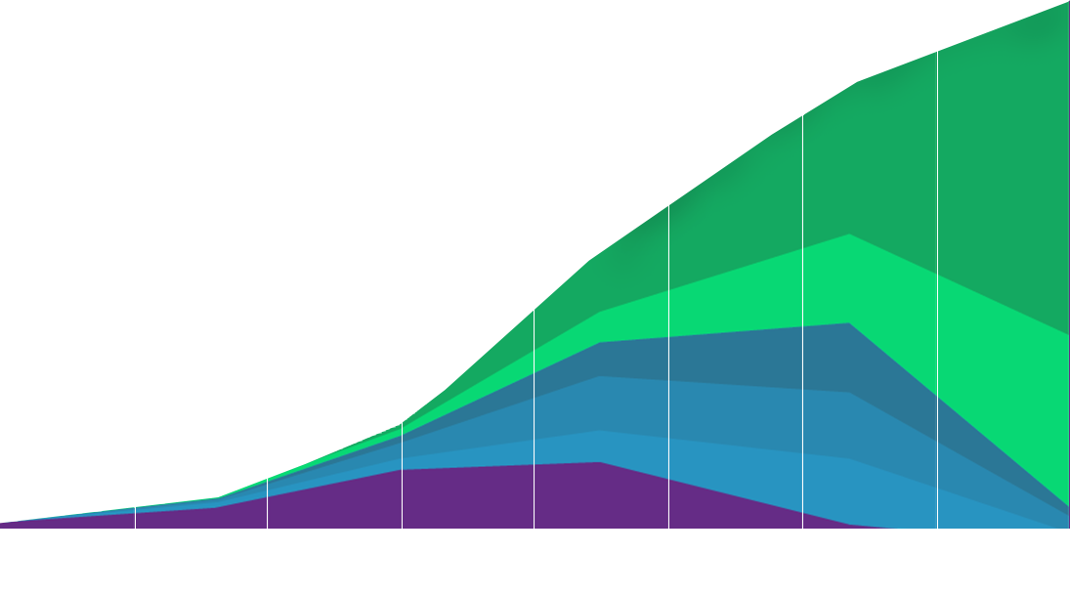
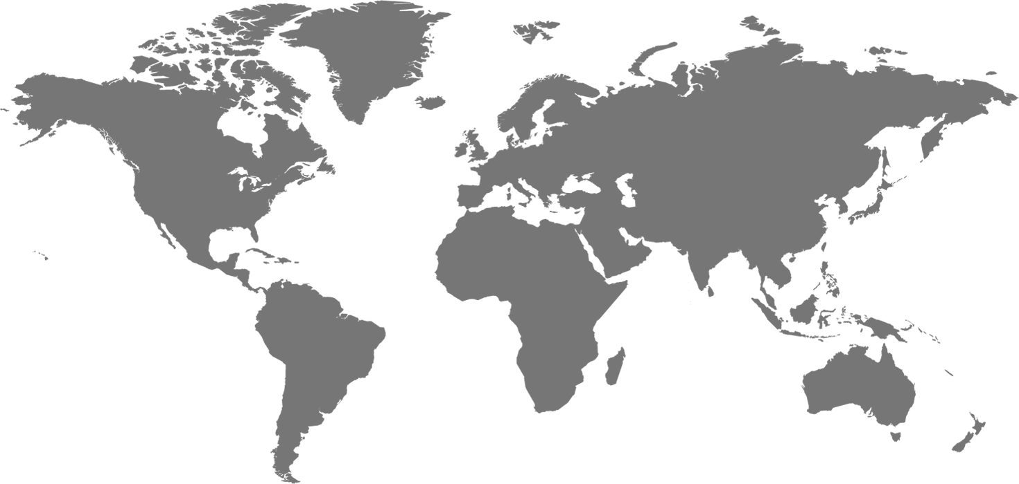

COMPUTE + DATA EXPLOSION = SMART AI
CLOUD
MOBILE
DIGITAL
ANALOG
1990
1995
2000
2005
2010
2015
2020
Notes:
Data is growing exponentially, new oil, Banks have much more data although more regulations
DL is compute and data heavy
Cloud compute revolution started 10 years ago
Machine learning and AI has become completely ubiquitous over the last 5 years since 2012 i.e. alexnet. Alex story, imagenet, revolution
AI ubiq and invis
DL good for lan,vis,RL due to ..
4

Slide 5
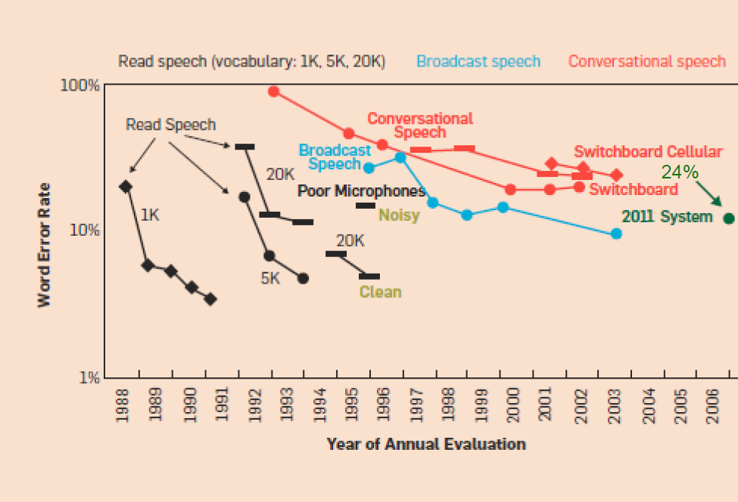
Improvements in Speech Recognition
2017: ~5%!
Human error: ~5%
Notes:
Do general chat
* Switchboard is a corpus of recorded telephone conversations that the speech research community has been using for more than 20 years to benchmark speech recognition systems. The task involves transcribing conversations between strangers discussing topics such as sports and politics. It’s important to stress that this dataset includes mouth sounds, coughs, people talking over one another, poorly recorded audio quality etc.
In 2011 the accuracy suddenly dropped 24% to around 10% word error rate!
This was done because researchers from Microsoft research applied a recurrent neural network to the problem for the first time.
A couple of months ago MSR released a new paper which got the WER down to 5.1%, on parity with the human error rate for conversational speech recognition.
5

Slide 6
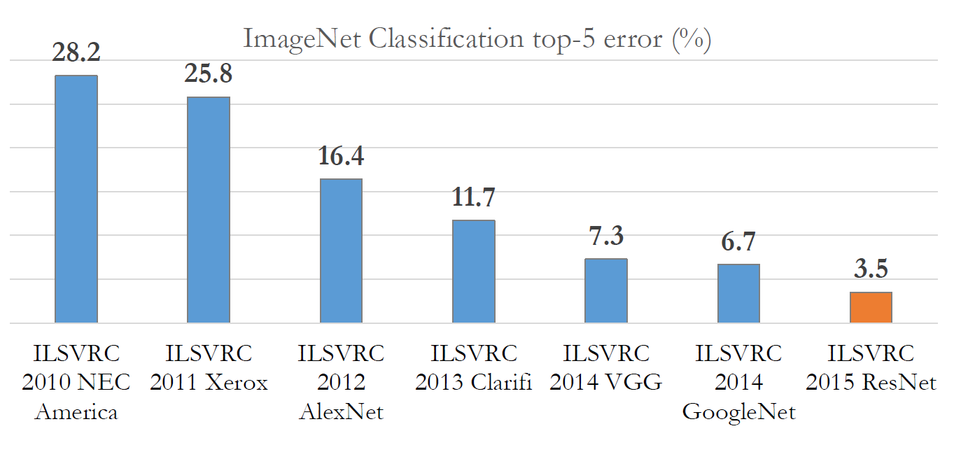
Improvements in Computer Vision
Improvements in Computer Vision
First deep learning system
2017: ~2.2%
ImageNet Large Scale Visual Recognition Challenge (ILSVRC)
Notes:
Since 2010, the annual ImageNet Large Scale Visual Recognition Challenge is a competition where research teams evaluate their algorithms on the given data set, and compete to achieve higher accuracy on several visual recognition tasks.
The imagenet image detection competition is like the annual Olympics of computer vision
In 2012 alex kri. Was the first guy to use a fast GPU to accelerate his CNN and he won the imagenet competition. The accuracy of his system was about 10% better than the previous year. In the machine learning world we were not used to seeing advances in a short space of time like this.
By the next year, almost every entry in the competition used a CNN when before nobody had even heard of CNNs
This year a team in China won the competition using an architecture called “Squeeze-and-Excitation Networks”. The big players stopped participating because they saw this problem as essentially solved, and indeed the detection competition was called off this year. They still run other competitions (for example; object localisation).
Having access to a large, labelled dataset and a GPU in combination with deep learning caused a quantum leap in computer vision.
6

Slide 7
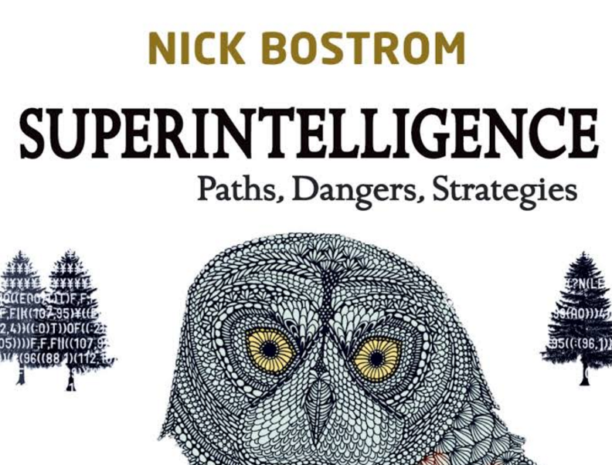

Don’t worry about General intelligence
Notes:
AI is getting overhyped in certain respects at the moment,
Existential risk of AGI spoken about by ;
Nick Bostrom, famous for the “argument from simulation”
Sam Harris
Elon Musk
AGI vs specialised, one thing well, in many much better than a human
NNs today learn a very “basic” representation which maps from one space to another, although I place a caveat on the word “basic” because as will become clear later, in many cases us humans have absolutely no intuition whatsoever on what the representation means.
Interesting from a philosophical perspective, if we ever did invent AGI, we would need to plan for it now
We wouldn’t be able to contain it
Or adapt fast enough
Parallel with nuclear weapons, which also changed mankind forever and we were a coinflip away from the brink of annihilation
Key point though is that we are not even close to AGI
I am a materialist, which means I think that consciousness exists inside our own heads and could theoretically be recreated

Slide 8
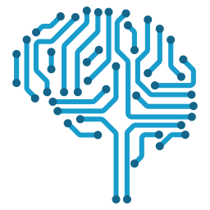
DO WORRY ABOUT ETHICS IN AI
Discrimination
Opaque AI
Data is not neutral
Manipulating markets and consumers/voters
Lack of human connection
Engineers are not philosophers (moral reasoning)
Privacy
Innocent till proven guilty?
Notes:
[this is just a tiny list to give you guys the gist of the ethical dilemmas we see in AI]
Discrimination
It’s illegal to discriminate on gender, but you can infer it from other variables, and you can discriminate on location. Everything is related; weather->tennis. If you can’t discriminate, does it make a mockery out of the market system?
Opaque
Almost impossible to understand what AI algorithms are doing
Data not neutral
Manipulating markets, Cambridge analytica
Lack of human connection, you are just becoming a number
Philosophy (ethics example)
Privacy
Anecdote about universal accountability; black mirror episode nosedive, in China they have a credit rating system which is used for getting jobs and loans, if you read the wrong article on the internet it could destroy your life. We have Instagram and social media now, imagine if there was universal accountability and something you said in a private context could destroy your life? Instagram etc is silo’d now but imagine if it was homogenous?
As humans we need private spaces to explore new ideas away from the judging eyes of others
Innocent till proven guilty, the terrorists who did the recent thing were known to police

Slide 9
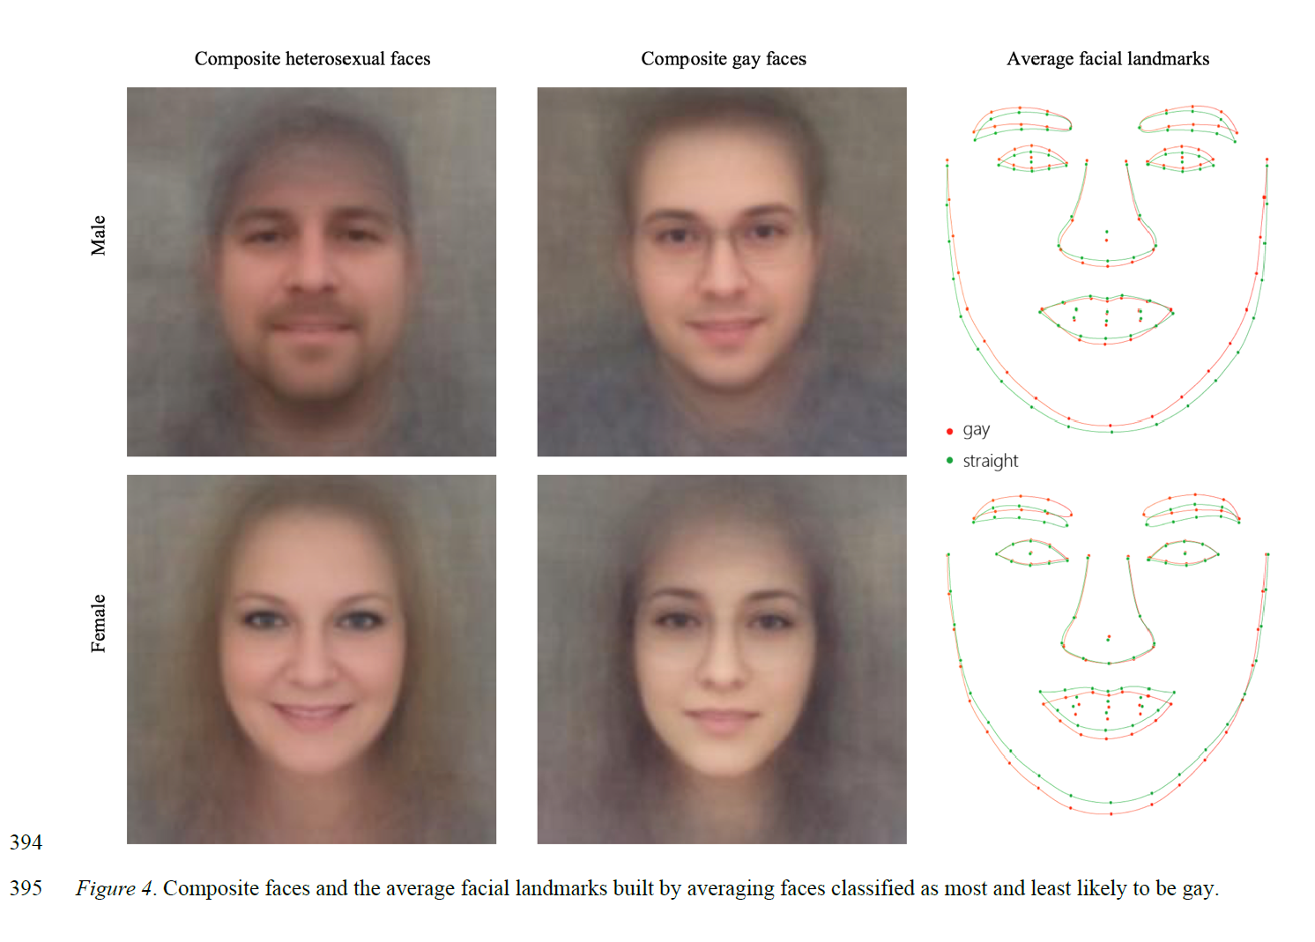
Physiognomy is back?
https://osf.io/zn79k/
2017 Wang, Y., & Kosinski, M.
Notes:
2017 Wang, Y., & Kosinski, M. (in press). Deep neural networks are more accurate than humans at detecting sexual orientation from facial images. Journal of Personality and Social Psychology.

Slide 10

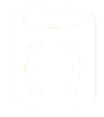

AZURE INTELLIGENT CLOUD
Information Management
Big Data Stores
Machine Learning and Analytics
Intelligence
Data Sources
People
Data Lake Store
Data Factory
SQL Data
Warehouse
Machine Learning Services
Cognitive Services
Data Catalog
Data Lake Analytics
Bot Framework
Web
Data Stores
Apps
Data Bricks and HDInsight
Event Hubs
SQL Azure
Cortana
Mobile
Apps
IoT Hub
CosmosDB
Stream Analytics
Bots
Dashboards & Visualizations
Storage Blob
IaaS Stores
Machine Learning Server
Sensors and devices
SQL Server 2016
… etc.
Power BI
Automated Systems
SSAS
Data
Storage
Intelligence
Action
Notes:
You can do embedded machine learning in all our storage technologies, we move the computation to where the data sits.
10

Slide 11
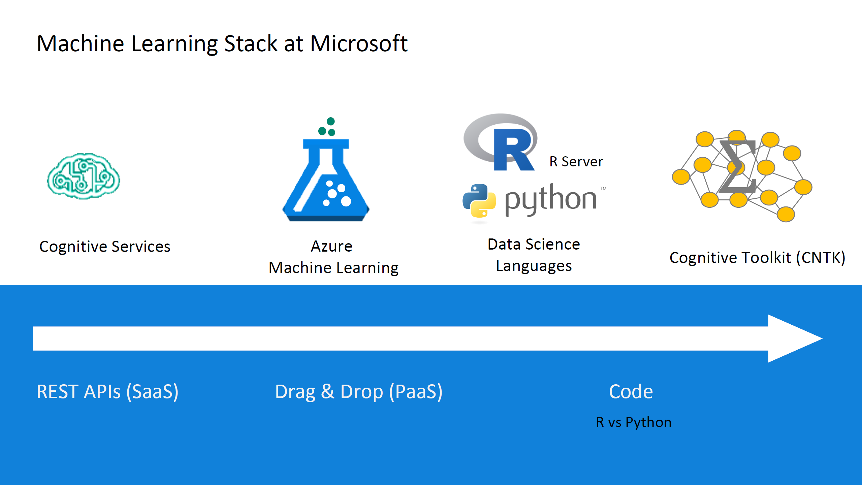



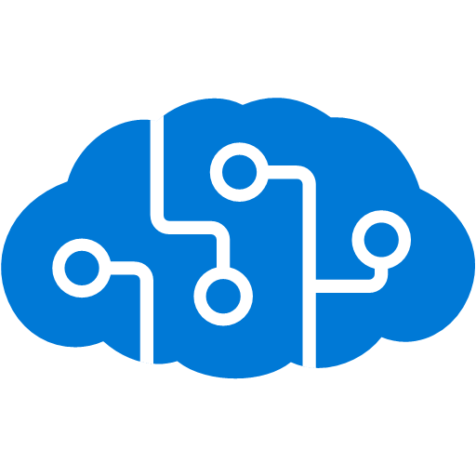


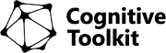
AZURE MACHINE LEARNING STACK
MMLSpark
Batch AI Training
Azure Notebooks
CosmosDB / Data Lake Analytics / SQL Server
Code-oriented
Data Science virtual machine
Pre-baked models
Code-oriented
Drag/drop visual UI
Cognitive Services
Data Bricks
ML Studio
ML Services
ML Server
CNTK
Software developer
Data scientist
Citizen data scientist
Data scientist
Data scientist
Applied Scientist
Private
Generative
SaaS
PaaS
Code-first
Containers
Notebooks
Onprem/Hybrid
IaaS
Discriminative
Framework
Notes:
Public vs private model
Saas services, paas services, then hybrid story on right
For our finance customers that reasonates very well, using ai tech on prem, progressively democratise, then transitioning to the cloud, some ai models require a massive amount of compute, hybrid model is key for this
We have noticed some key trends
ML is becoming a form of software development, not just consumption by developers but also with deep learning composing the models themselves
Rise of hybrid training and scoring scenarios
Push scoring and inference to the event (edge, cloud, prem)
Rise of deep learning
Diversification of hardware CPU/GPU/ASICS/FPGA
Code first
Novel prediction architectures, model fit needs
Key Challenges
Data prep
Model management and deployment
Model lineage and auditing
Explainabilty
11

Slide 12
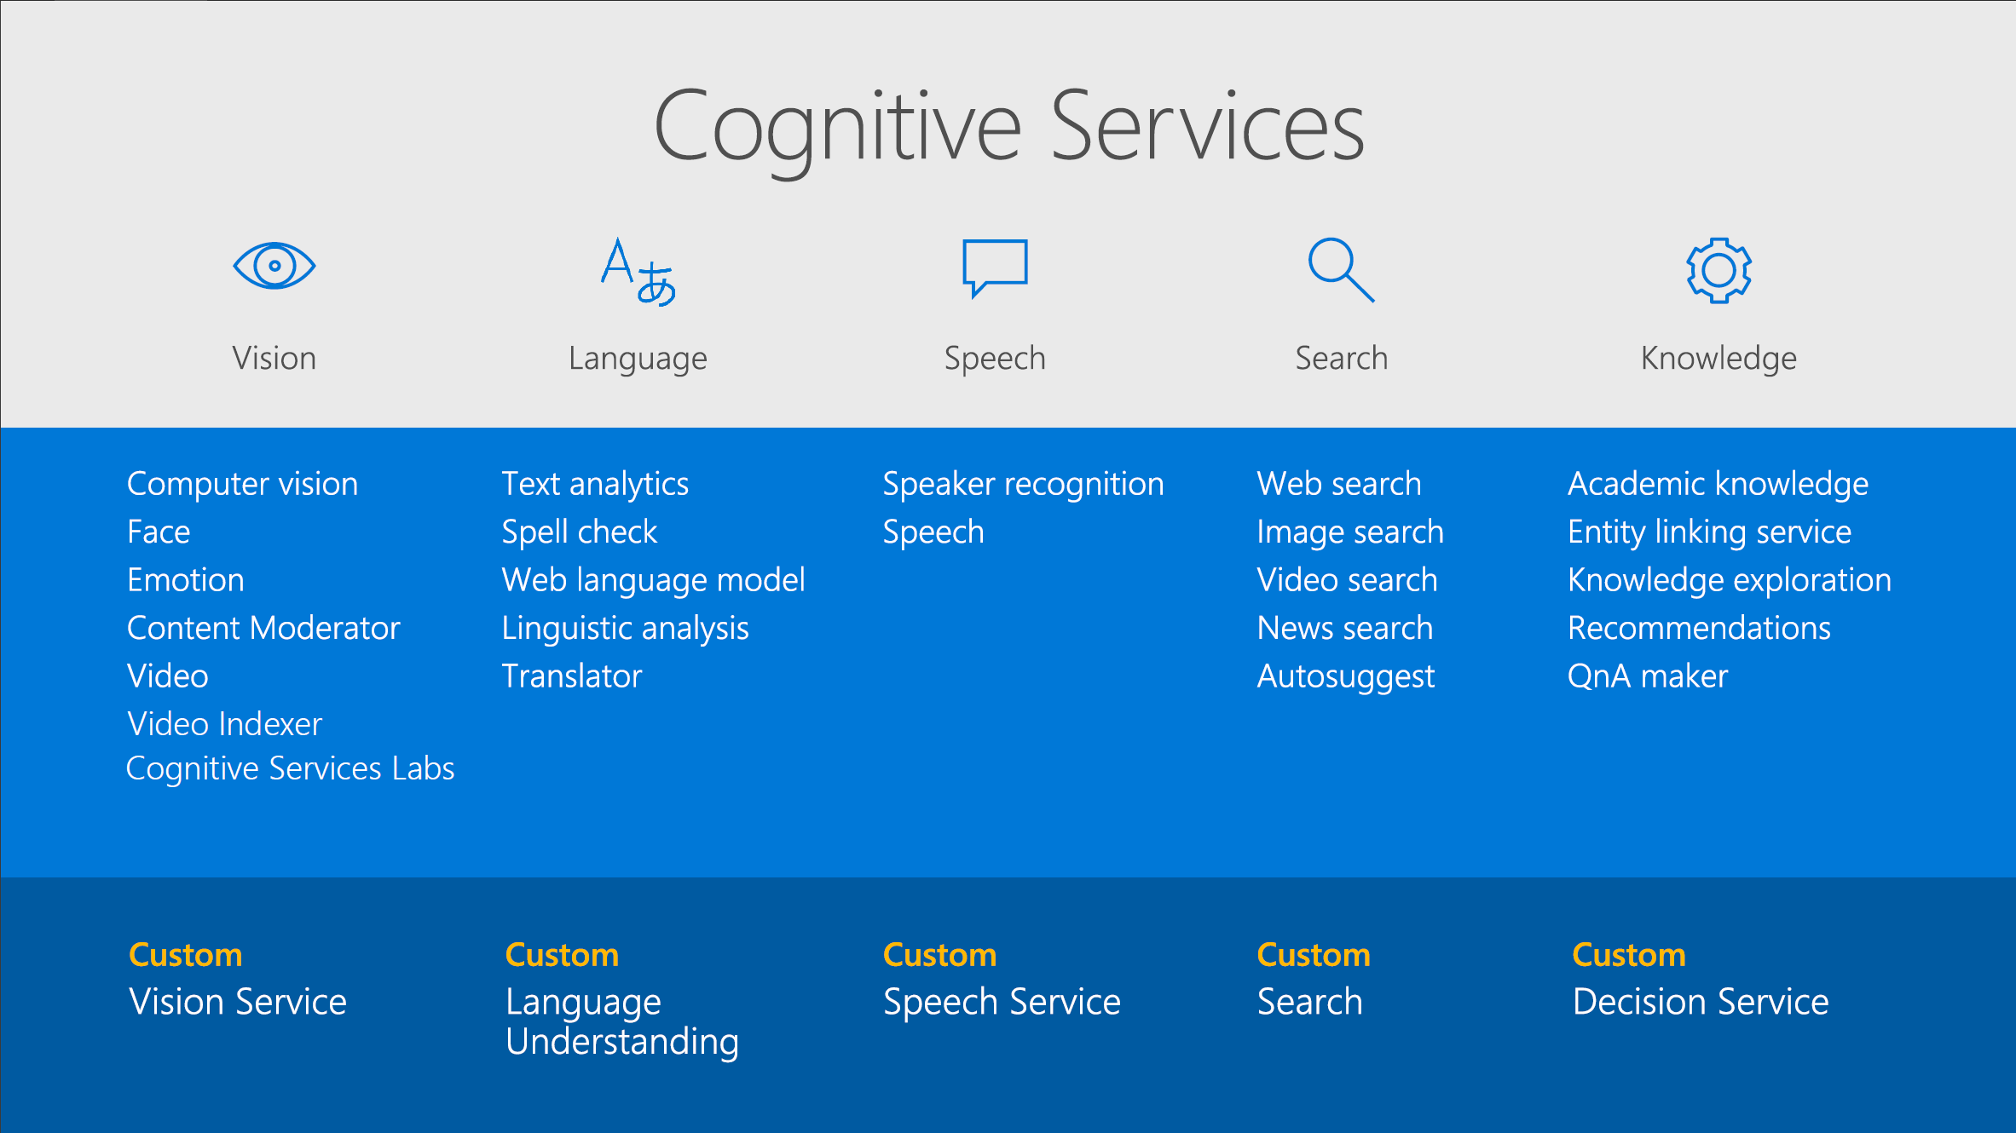
COGNITIVE SERVICES
Notes:
GOTO A DEMO OF COGSERV
12

Slide 13
MACHINE LEARNING PORTFOLIO
Microsoft ML & AI products
Build your own or consume pre-trained models?
Build your own
Consume
Cognitive services, bots
Which experience do you want?
Code first
Visual tooling
Deployment target
(On-prem) ML Server
(cloud)
ML services / Data Bricks
(cloud)
ML Studio
What engine(s) do you want to use?
On-prem Hadoop
SQL Server
SQL Server
Spark
Hadoop
Azure Batch
DSVM
Azure Container Service
Notes:
Slide adds clarity to where some of our technologies fit in based on use case
Talk through the slides
© Microsoft Corporation. All rights reserved. MICROSOFT MAKES NO WARRANTIES, EXPRESS, IMPLIED OR STATUTORY, AS TO THE INFORMATION IN THIS PRESENTATION.
8/13/2018 11:32 AM
13

Slide 14

WHAT IS MACHINE LEARNING?
A machine learning from previous experience (data) so that it can perform some task better based on that experience.

Slide 15
MACHINE LEARNING != DATA SCIENCE
The data scientist is trying to understand the data, the ML person is building a working model which may not be interpretable.

Slide 16
INDUCTIVE INFERENCE
ML algorithms often ”induce” a generic and separate artefact or “decision function”, learned from data.

Slide 17

Images/Sequences
On-line/Offline
Regression
Supervised
Anomaly detection
Tell the machine the correct answer
Embeddings
Agent-based learning
Unsupervised
Classification
Tell the machine nothing, let it observe the world
Reinforcement Learning
Dimensionality Reduction
Clustering
Learning from delayed rewards
TYPES OF MACHINE LEARNING
Autonomous cars
Notes:
Worth mentioning that almost all machine learning in the real world is unsupervised, and almost all machine learning is supervised. As artificial general intelligence so poor, we are a long way from developing decent unsupervised learning although it can still work well for certain purposes.
17

Slide 18
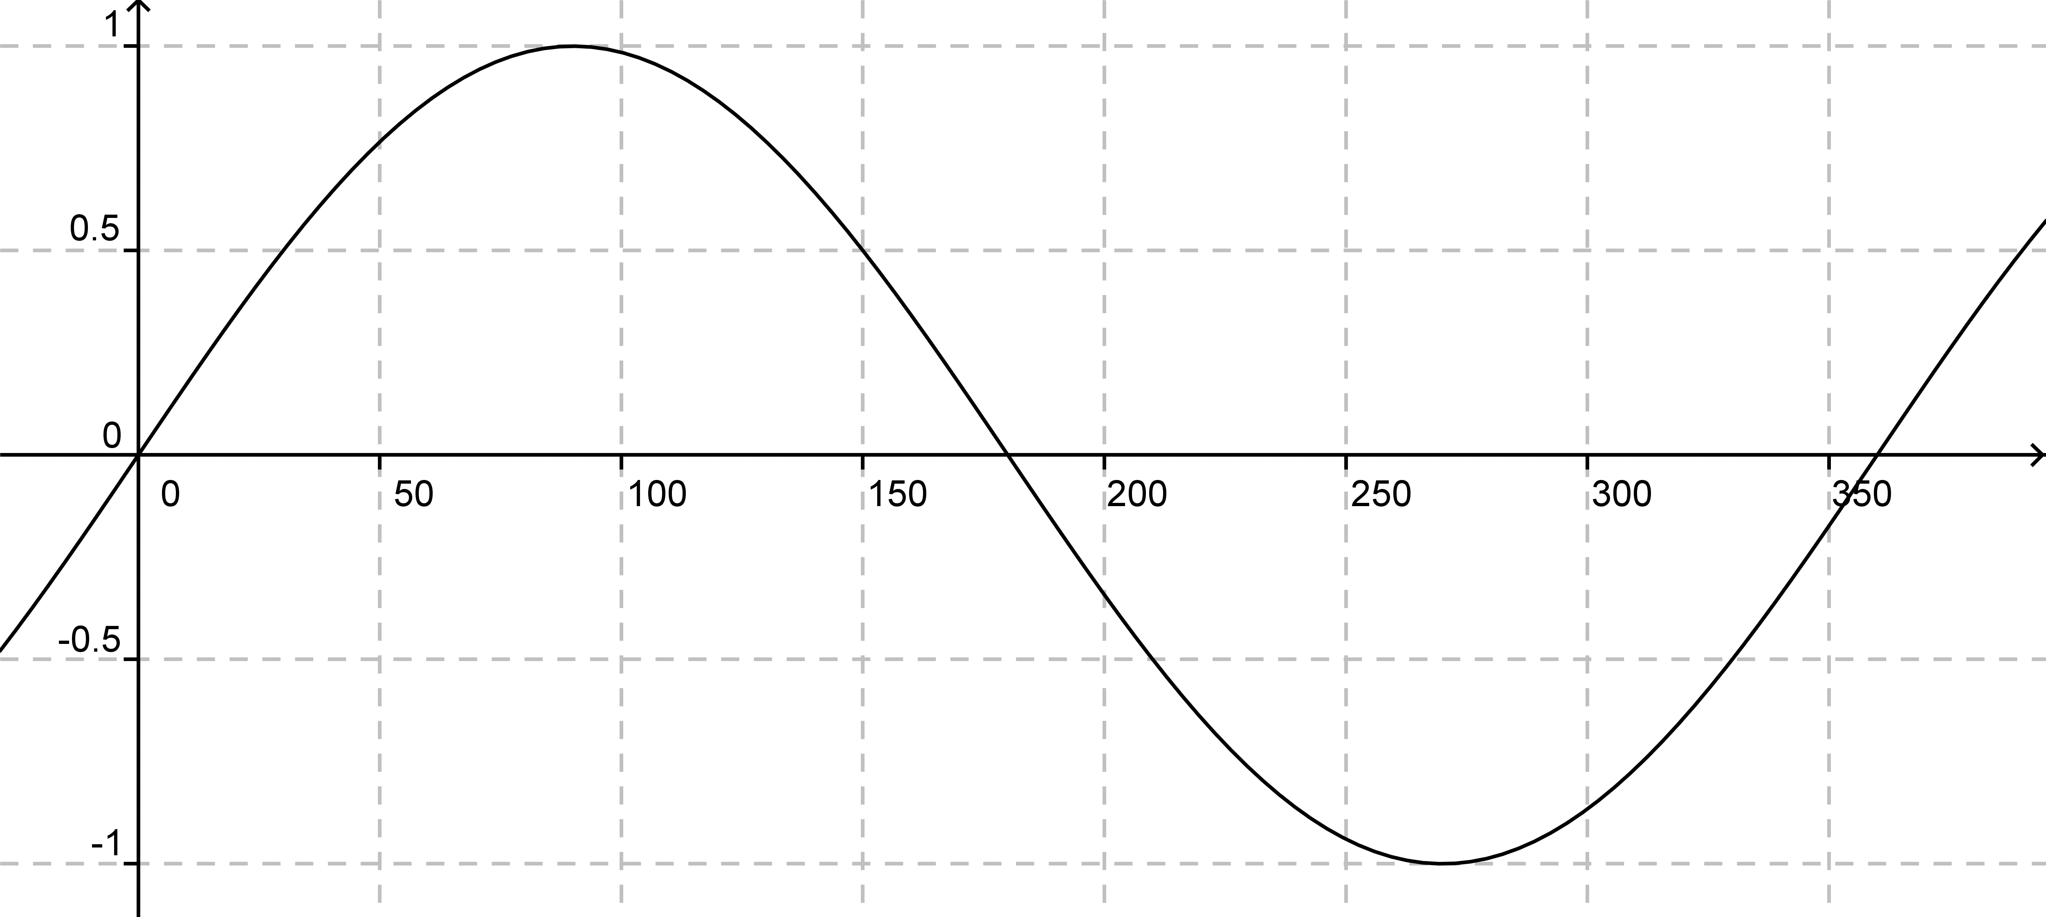
A SIMPLE SINSOIDAL FUNCTION
F(X)=
Machine learning approximates a function, which we may only have a few examples of.
Notes:
SL “Tell machine what the correct answer is”
US “”
18

Slide 19
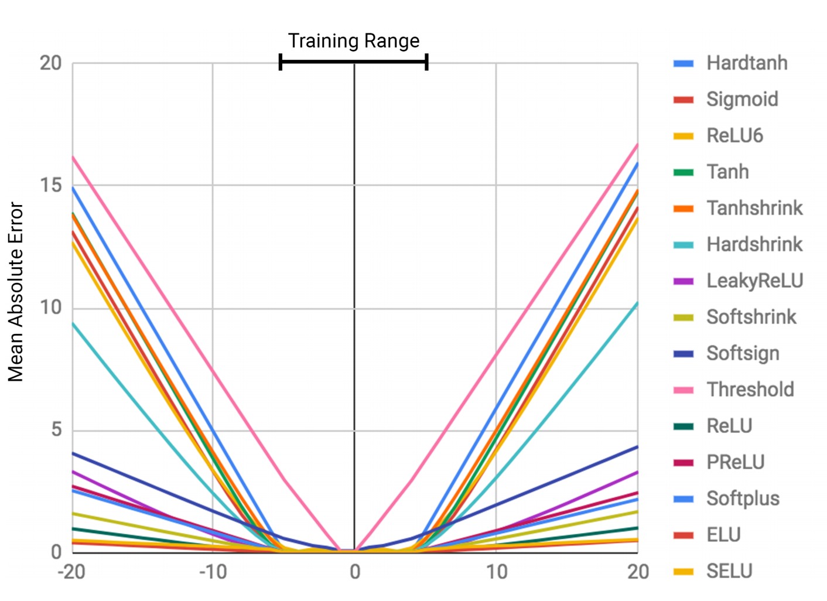
INTERPOLATION VS EXTRAPOLATION
ML algorithms perform very, very badly on data out of range. They don’t generalise as well as you think. Trask et al 2018 (DeepMind)

Slide 20
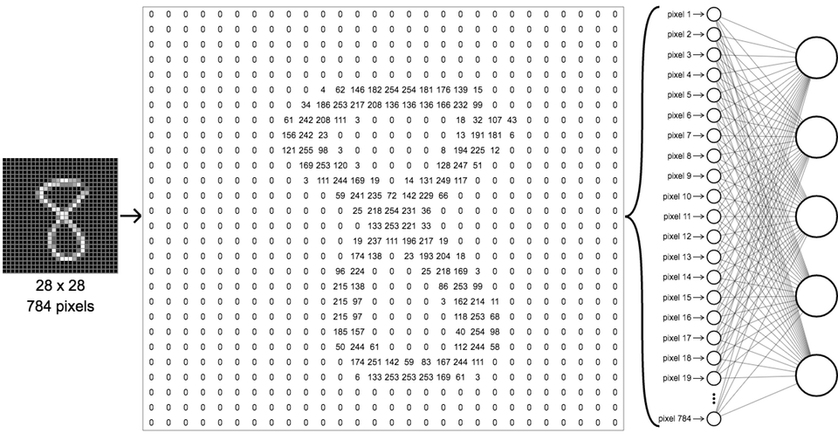
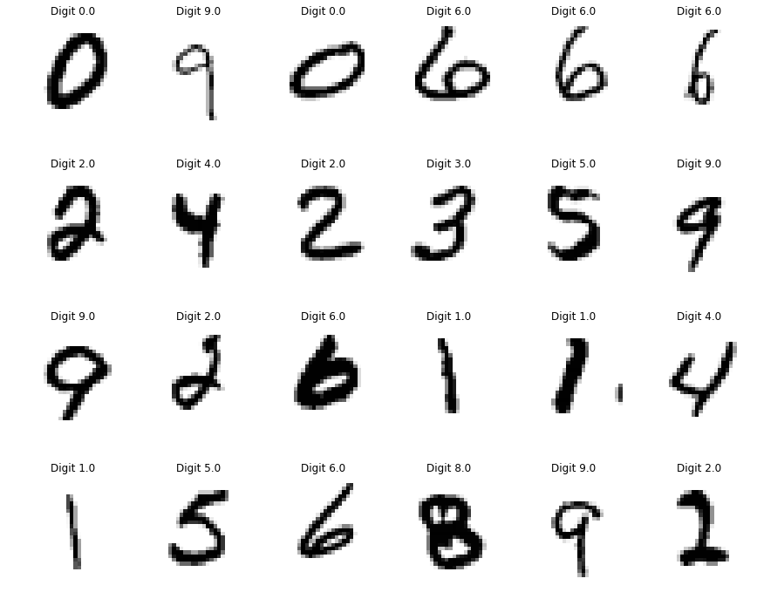
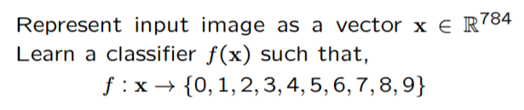
MNIST DIGIT CLASSIFICATION
Notes:
20

Slide 21
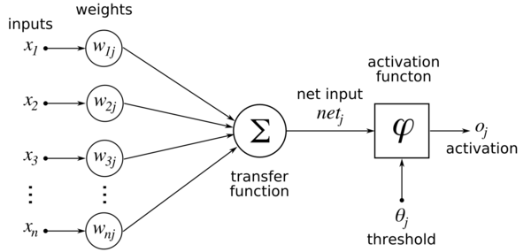
WHAT IS A NEURAL NETWORK?

Slide 22
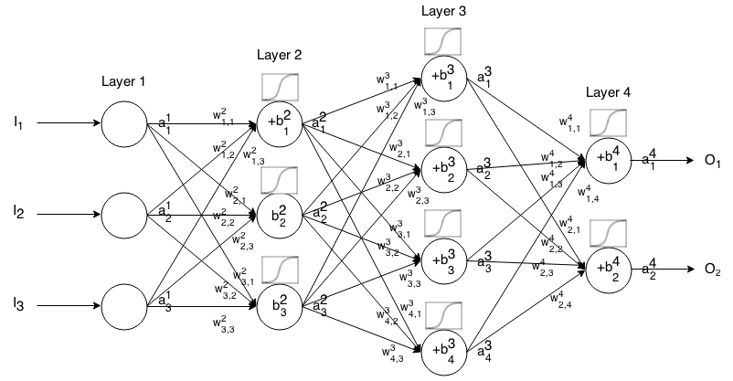
WHAT IS A DEEP NEURAL NETWORK?

Slide 23

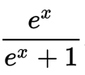
Sigmoid SQUASHING Function
Notes:
large negative numbers become 0 and large positive numbers become 1
the sigmoid non-linearity has recently fallen out of favor and it is rarely ever used
(-) Sigmoid outputs are not zero-centered.
(-) Sigmoids saturate and kill gradients (Vanishing gradient problem). [A very undesirable property of the sigmoid neuron is that when the neuron’s activation saturates at either tail of 0 or 1, the gradient at these regions is almost zero. ]

Slide 24
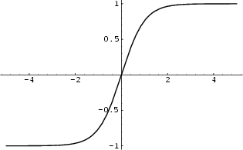
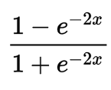
TANh SQUASHING Function
Notes:
* its activations saturate(-), but unlike the sigmoid neuron its output is zero-centered (+).

Slide 25
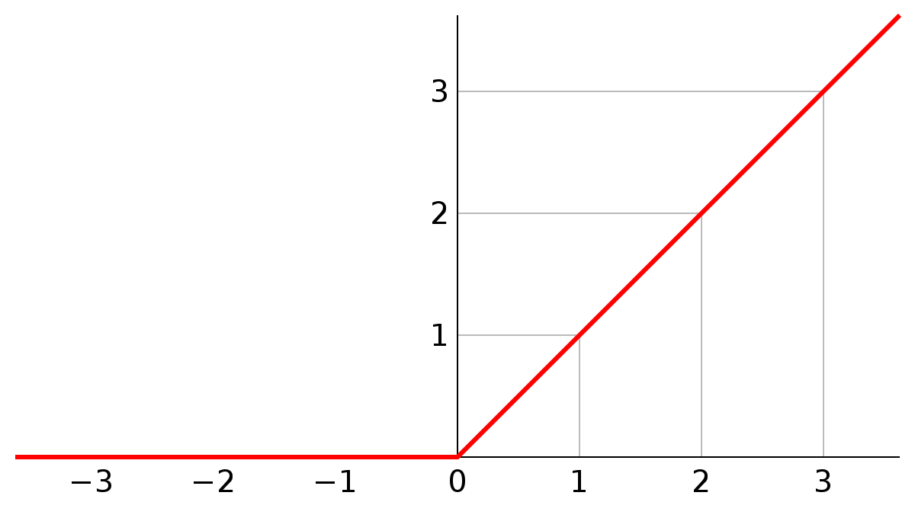
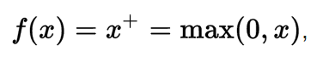
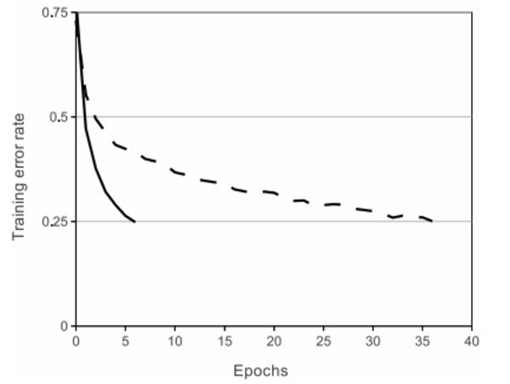
RELU SQUASHING Function
Notes:
Relus HIDE information
Relus CONVERGE faster (6x on average) - A plot from Krizhevsky et al. (pdf) paper indicating the 6x improvement in convergence with the ReLU unit compared to the tanh unit.
Almost always use RELUS
(+) No expensive operations (exponential)
(-) Not centred around zero
(-) ReLU units can be fragile during training and can “die”, you may find that as much as 40% of your network can be “dead”

Slide 26
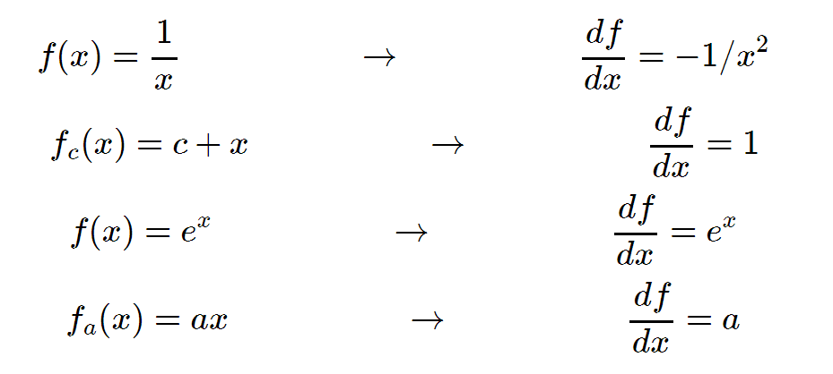
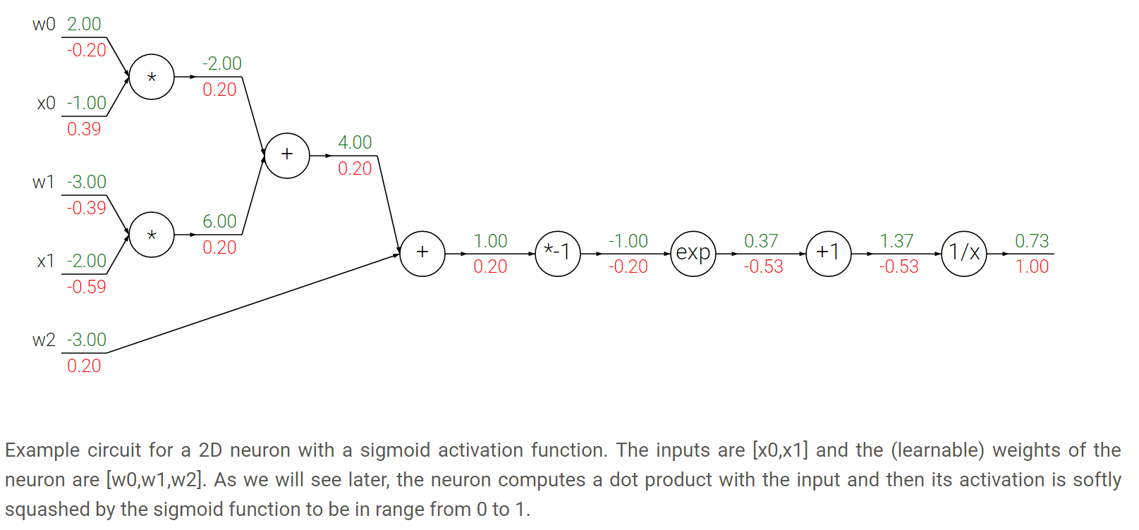
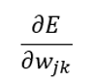
BACKPROPAGATION

Slide 27
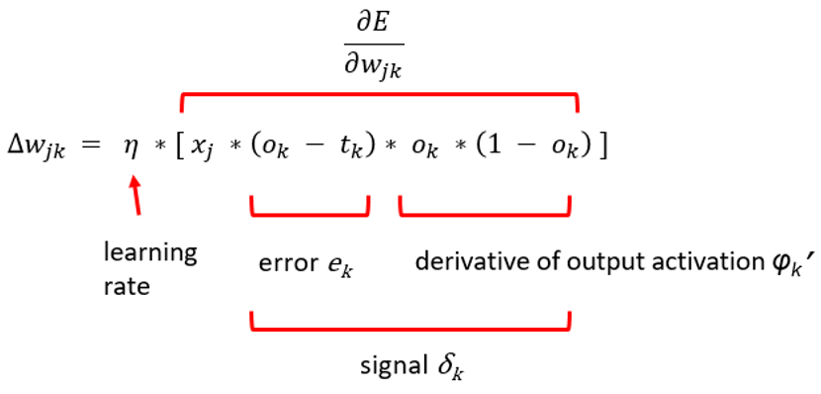
Weight Update

Slide 28
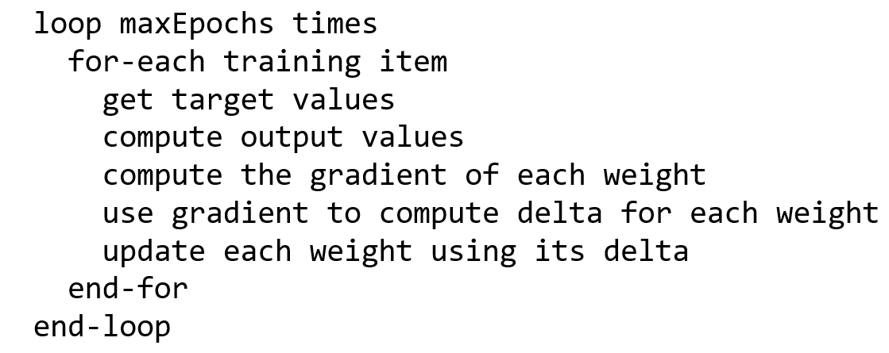
Backprop Algorithm

Slide 29
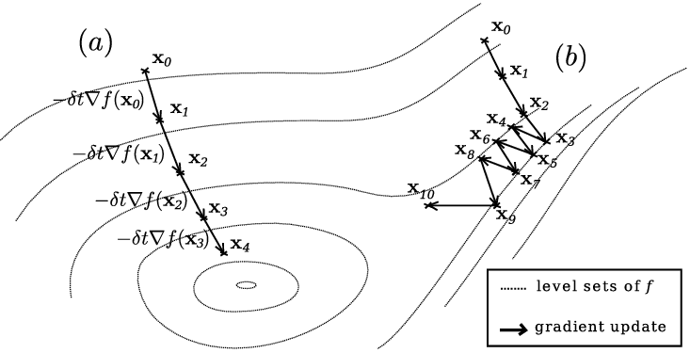
OPTIMIZATION/GRADIENT DESCENT
WEIGHT UPDATES IN EPOCHS / TRAINING DATA SPLIT INTO MINIBATCHES

Slide 30
UNIVERSAL MACHINE LEARNING PROCESS
Define problem
Define success
Validation process
Vectorise/normalize data
Develop naïve model
Refine model based on validation performance
Notes:
This might sound obvious but here is some high level guidance.
Machine learning is about understanding the problem domain so we can determine what to attempt to predict, given what data.
How to measure success, is a prerequisite for any successful application of machine learning, and it isn’t something that advanced tools like Keras or CNTK will help you with.
First, you should define the problem: what data is available, and what are you trying to predict? For example, would you need to collect more manual labels? I personally find that getting decent labels is a perennial problem, especially in NLP.
Identify a way to reliably measure success on your goal. For simple tasks, this may be prediction accuracy, but in many cases it will require sophisticated domain-specific metrics. [example, music thing]
Prepare the validation process that you will use to evaluate your models. In particular, you should define a training set, validation set, and test set.
Vectorize your data, by turning it into vectors and preprocessing it so that NNs can read it more easily i.e. we spoke about homogenous features earlier
Develop a first model that beats a trivial common-sense baseline. [naïve FREE] This demonstrates that machine learning can work on your problem. This might not always be the case!
Gradually refine your model architecture by tuning hyperparameters and adding regularization. Make changes based on your performance on the validation data only, not the test data nor the training data. Remember that you should manage to get your model to overfit. When you overfit you are demonstrating that you have a model capacity level that is sufficient, and only thencan you start regularizating or downsizing your model.

Slide 31
DISTILLED CONCEPTS OF DEEP LEARNING

Slide 32
3 TYPES OF NETWORK ARCHITECTURE
DENSELY CONNECTED NETWORKS
CONVOLUTIONAL NEURAL NETWORKS (MODEL SPACE)
RECURRENT NEURAL NETWORKS (MODEL TIME)
Notes:
[FREE] Talk about how in the old days we used to do manual feature extraction with hand crafted features
[FREE] The algorithms would just solve an optimization problem and combine those features using some weighting
[FREE] You still have to do feature extraction in DL, there is a trade-off, homogenous features
Talk through image

Slide 33
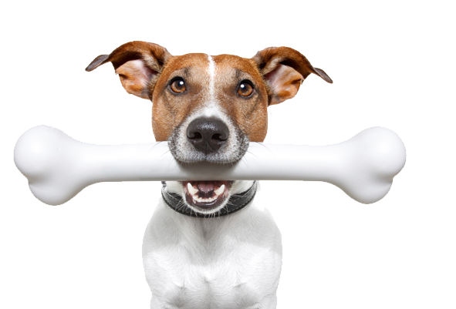
ENTIRE MACHINE IS TRAINABLE
The networks have many levels of depth
Machine learns a hierarchy of representations i.e. “representation learning”
Less feature extraction required (still need transposition, normalization etc)
Hand crafted features
Feature Extractor
Trainable Classifier
Traditional ML
Representations are hierarchical and trained automatically
Low Level Features
Mid Level Features
High Level Features
Trainable Classifier
Deep Learning
Notes:
[FREE] Talk about how in the old days we used to do manual feature extraction with hand crafted features
[FREE] The algorithms would just solve an optimization problem and combine those features using some weighting
[FREE] You still have to do feature extraction in DL, there is a trade-off, homogenous features
Talk through image

Slide 34
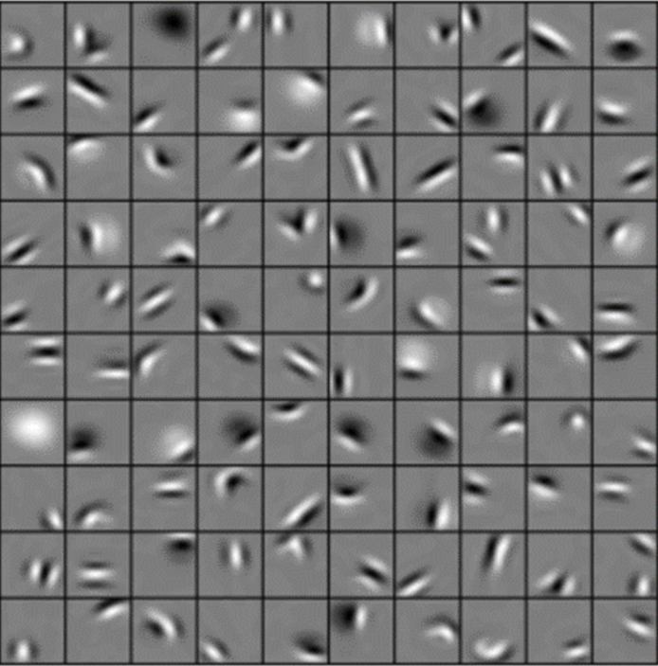
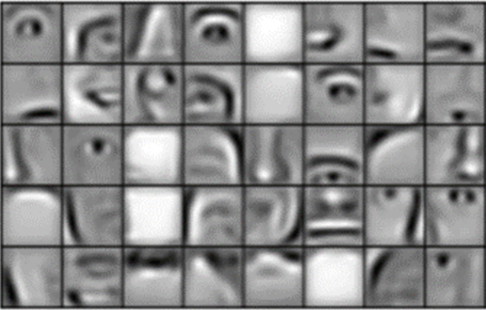
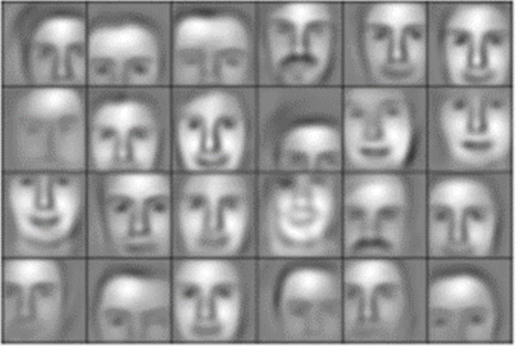
Low Level Features
Mid Level Features
High Level Features
REPRESENTATIONS ARE LEARNED AUTOMATICALLY

Slide 35
UNIVERSAL FUNCTION APPROXIMATORS
Unlike other shallow ML algorithms; you can map between data domains
Generative models are possible, not just discriminative
SEQUENCES
SEQUENCES
We learn a spatial transformation between the two
SPEECH
SPEECH
LANGUAGE
LANGUAGE
IMAGES
IMAGES
[…]
[…]
Notes:
Before, in the days of shallow learning algorithms, we had very specialised algorithms for each predictive task.
[FREE] hidden markov models
NNs can handle any predictive task and are composable.
Paper cup analogy
Can map from the time domain into the space domain and vice versa

Slide 36
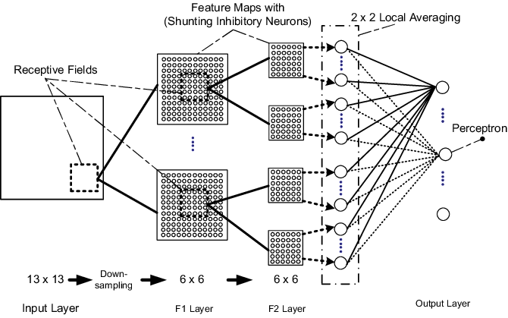

NATIVE DATA-DOMAIN FEATURES
Unlike other algorithms, NNs can natively encode useful and obvious relationships in the data domain
Local spatial dependencies (vision) i.e. CNNs
Time dependencies (language, speech) i.e. RNNs
Convolutional Neural Networks
Recurrent Neural Networks
Notes:
[FREE] In the old days, detect dog in image, SVM…
The kind of thing you would be doing as a domain expert is applying various types of 2d convolution filtering to the image
In CNNs, the convolution filters are learned as part of the training process!
Traditional shallow learning algorithms had no concept of your how your input data was related, spatially or temporally.
You could quite literally randomly shuffle the data in the input space, and the algorithm would produce largely the same result (depending on whether the data was identically distributed and the algorithm was deterministic etc).
Use FFT example music
Plenty of domains care a lot about the relationships between items of data, take images for example which have a local spatial dependencies. Pixels are clearly related to ones in the vicinity. And language, words are clearly related to those in the vicinity. Before we had to do some manual hacks to transform the data outside of the time or space domain; like applying some feature extraction to images, or capturing N-grams for language. Neural networks can understand the data domain natively and build features from it dynamically as part of the training process.
The three families of network architectures that you should be familiar with are densely-connected networks, convolutional networks, and recurrent networks.

Slide 37
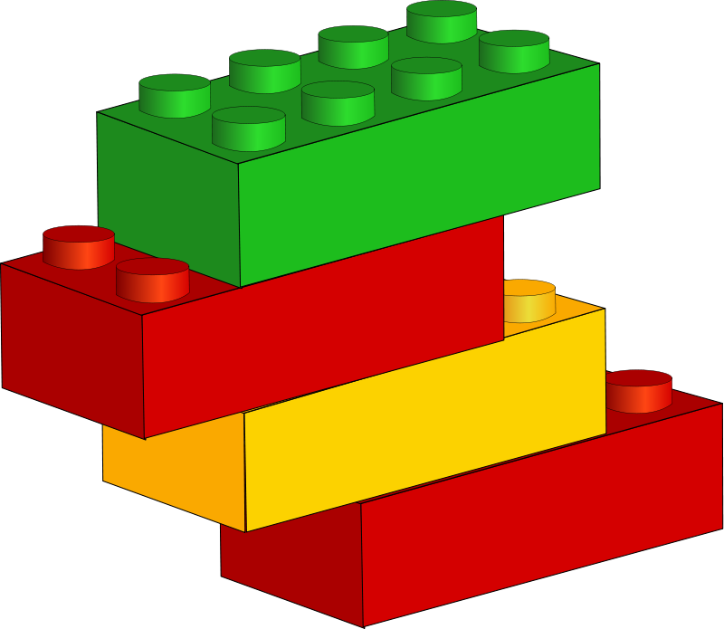
COMPOSABILITY
Composability
ML is becoming a form of software development
ML models are like software
Notes:
Talk about composability
There is a massive parallel with software here, DL is becoming a new form of software development and most of its practitioners have a software background not an academic background. You don’t need to be a scientist or a mathematician to do deep learning
Before --- different domains of ML would have their own specialised algorithms, modalities and execution contexts, and there would be a lot of glue code performing feature extraction and wiring up the components. Now the end-to-end prediction architectures can be described as a computation graph in any deep learning library
The people who work on DL tend to be software type people
Pre-existing deep learning components can be composed together in an entirely new way, like existing software development.
Language generating RNN example
On the Lego analogy; ideologically; this is where deep learning should be and will be, but isn’t quite there yet. We still don’t have the interoperability we want between frameworks for example.

Slide 38
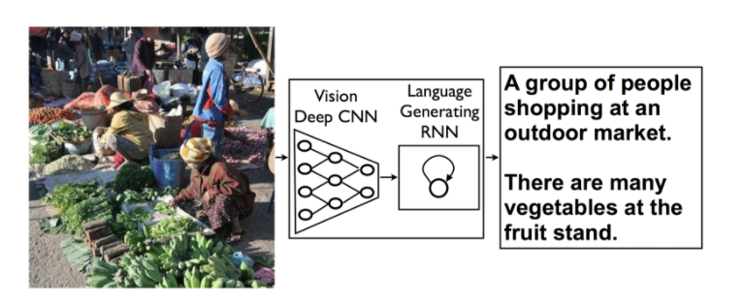
Building PREDICTIVE ARCHITECTURES Like Lego Blocks
(Vinyals, et al. (2014))
Notes:
Lego, cross domain concept

Slide 39
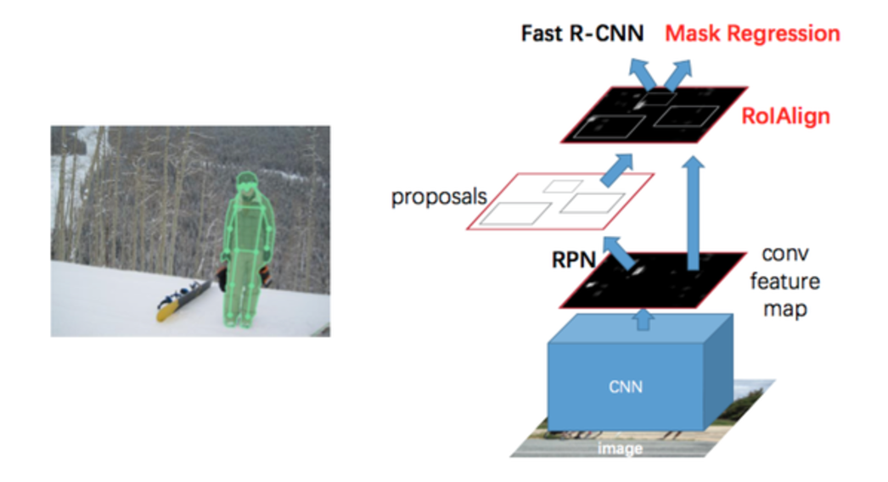
MaSk R-CNN ARCHITECTURE (2017)
Architecture COMPOSABILITY

Slide 40
WHY USE DEEP LEARNING?
I WANT TO MODEL TIME OR SPACE DEPENDENCIES
I HAVE A LOT OF DATA AND WANT A LARGE, NUANCED MODEL
“SOFTWARE 2.0” / NOVEL PREDICTION ARCHITECTURES
GENERATIVE MODELS
Notes:
[FREE] Talk about how in the old days we used to do manual feature extraction with hand crafted features
[FREE] The algorithms would just solve an optimization problem and combine those features using some weighting
[FREE] You still have to do feature extraction in DL, there is a trade-off, homogenous features
Talk through image

Slide 41
WHY (NOT) USE DEEP LEARNING?
I NEED MODEL INTEPRETABILITY
I NEED PARSIMONY / LOW COMPUTE
I AM WORRIED ABOUT BIAS
I NEED TO UNDERSTAND MY DATA
Notes:
[FREE] Talk about how in the old days we used to do manual feature extraction with hand crafted features
[FREE] The algorithms would just solve an optimization problem and combine those features using some weighting
[FREE] You still have to do feature extraction in DL, there is a trade-off, homogenous features
Talk through image

Slide 42
Two Innovative DL Architectures

Slide 43
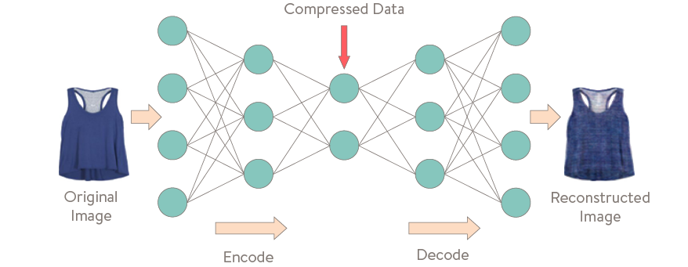
AUTOENCODERS
Autoencoders are an unsupervised method to compress information into an “embedding” similar to unsupervised dimensionality reduction.

Slide 44
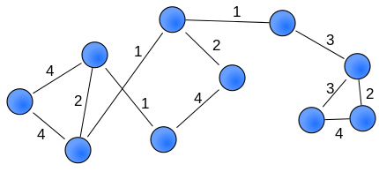
VERY ADVANCED NOVEL ARCHITECTURES (GANS)
An example; generative adversarial networks
Game-theoretical approach to deep learning
RANDOM VECTOR
GENERATOR NETWORK
FAKE IMAGE
DISCRIMINATOR NETWORK
REAL/FAKE
RANDOM INDEX
TRAINING SET
REAL IMAGE
Goodfellow et al. NIPS 2014
Notes:
Generator net maps random numbers to images
Discriminator learns to tell real from fake images
Generator can cheat; it knows the gradient of the output of the discriminator with respect to its input
Over time it gets harder and harder for the discriminator to tell real from fake
44

Slide 45
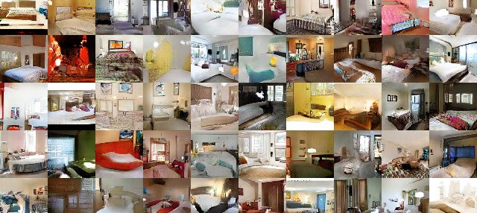
IMAGES GENERATED WITH GANS

Slide 46
Neural Network Playground

Slide 47

Predicting insurance premiums in a production data-science pipeline
Notes:
Intro to customer:
Admiral group, maths/stats/SAS/SQL/Tableau stack, had never used Git or Python
They have realised the value they can unlock in their vast dataset of customers and their respective quotations from the insurers.

Slide 48
Data
activityID | Age | Convictions | No Claims Bonus | Hour of day | Vehicle Value | ------- | Insurer1 | Insurer2 | Insurer3 | Insurer4 | --------
4675123 | 19 | Y | Y | 02:00 | 10000 |  | 4700 | 5100 | 4800 | 5000
7684565 | 45 | N | Y | 17:00 | 4100 |  | 600 | 640 | 580 | 710

Slide 49
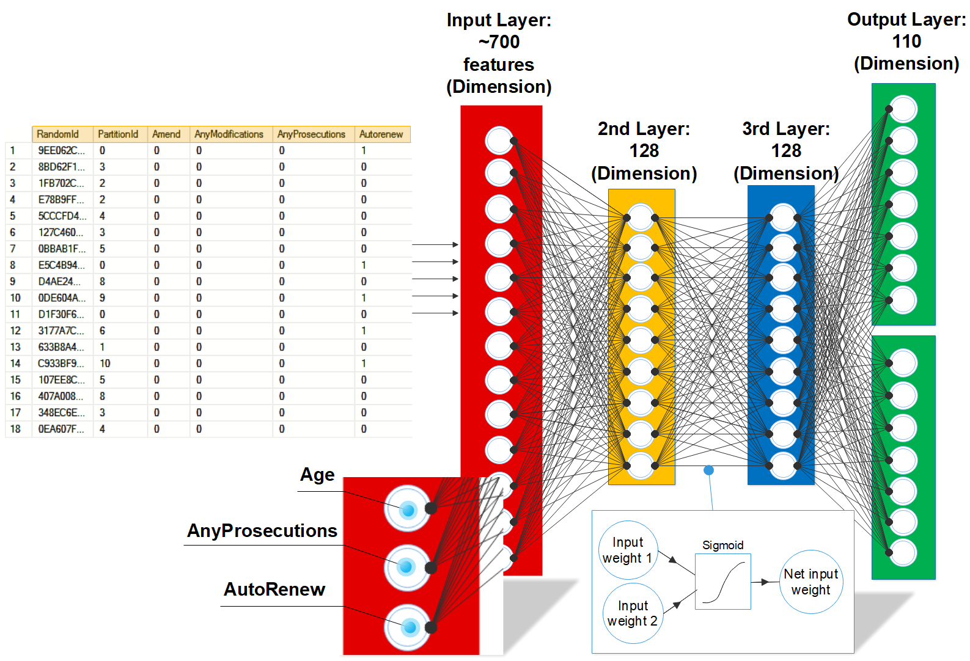
Model
Premium predictions (e.g £500)
Quote predictions (YES/NO)

Slide 50
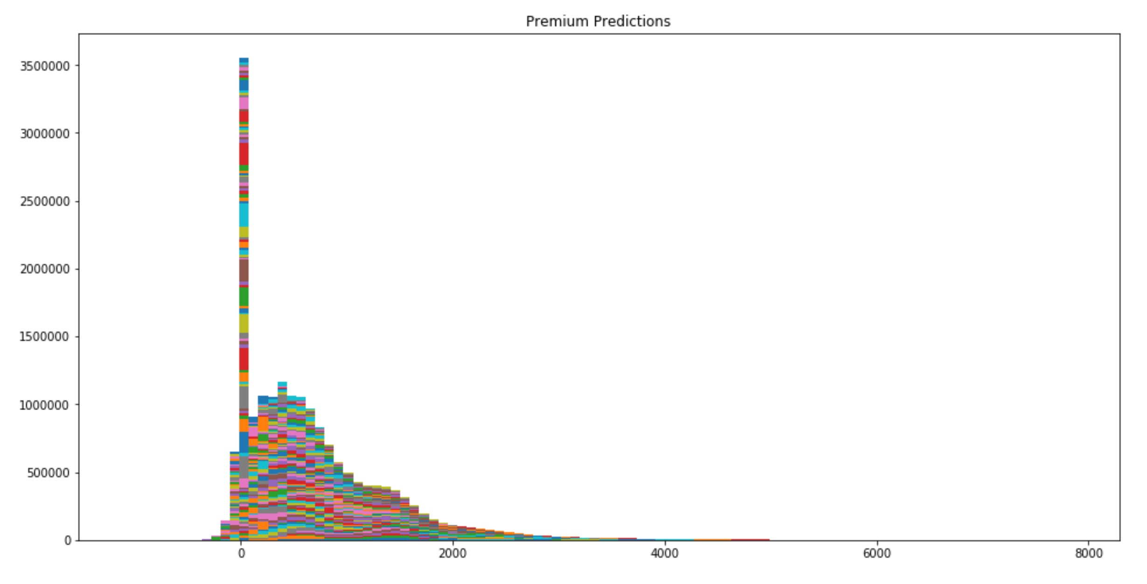
Model results on test data
Notes:
When working on large datasets, avoid visual inspection of individual training records or predictions or small groups. We assumed incorrectly that the model was predicting the same thing every time, this assumption cost us a fair bit of time. Always visualise over a large sample, perhaps image plots for input data, or histograms for predictions or residuals
I don’t think a shallow learning technique like a regression would have picked out zero as a special case.

Slide 51
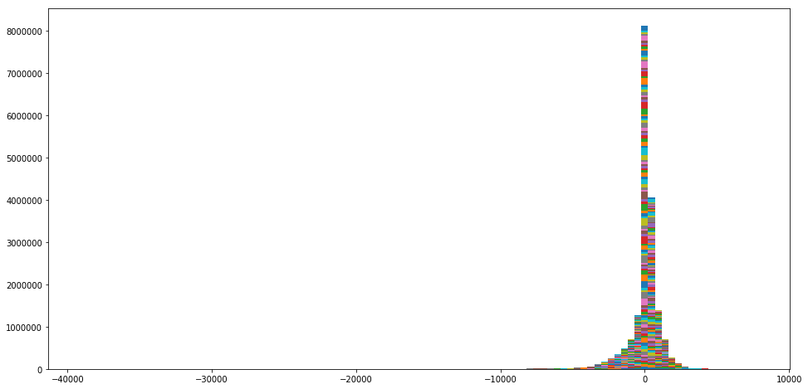
Errors on premiums (actual – predicted)

Slide 52
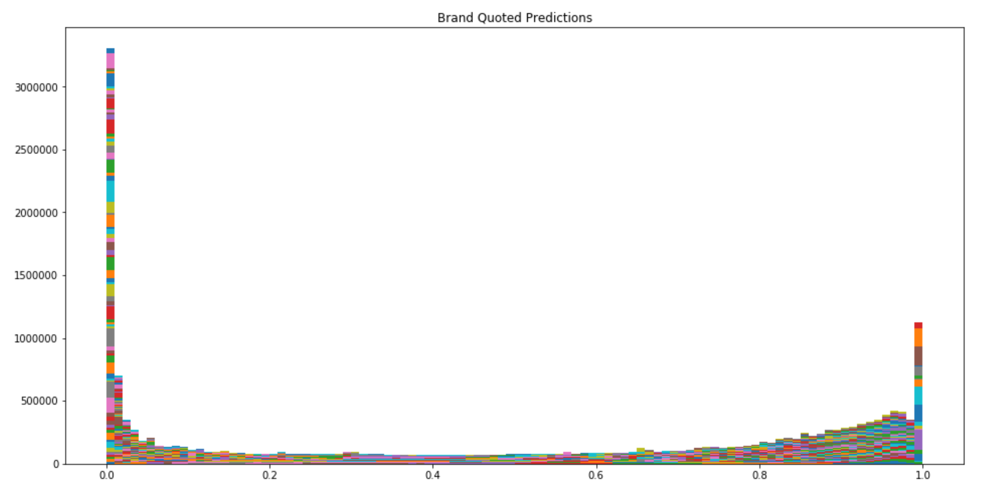

Slide 53
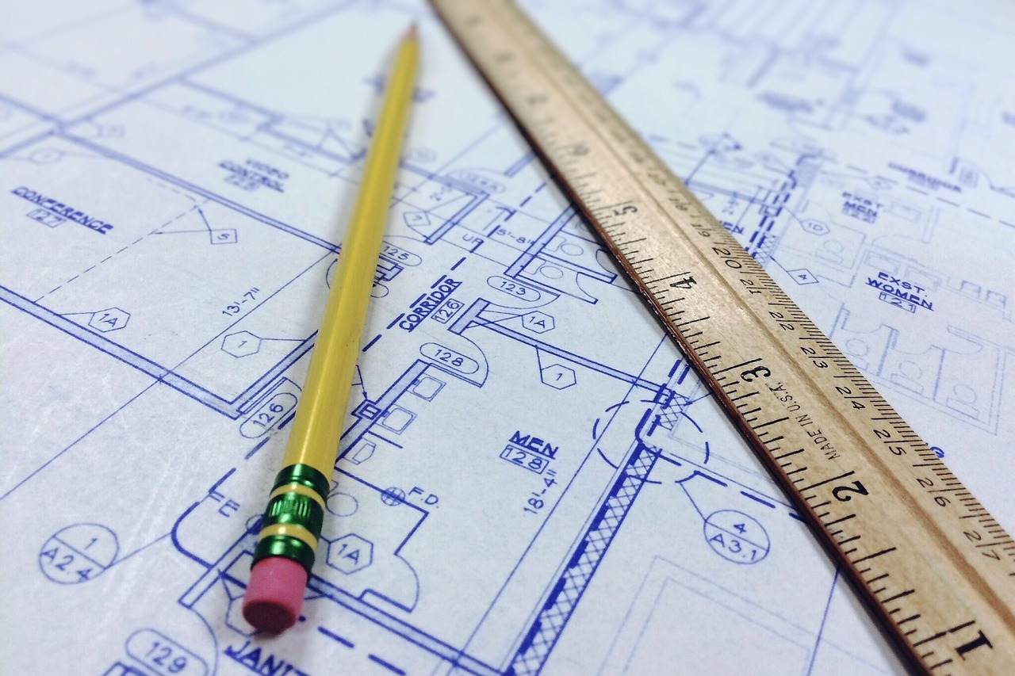
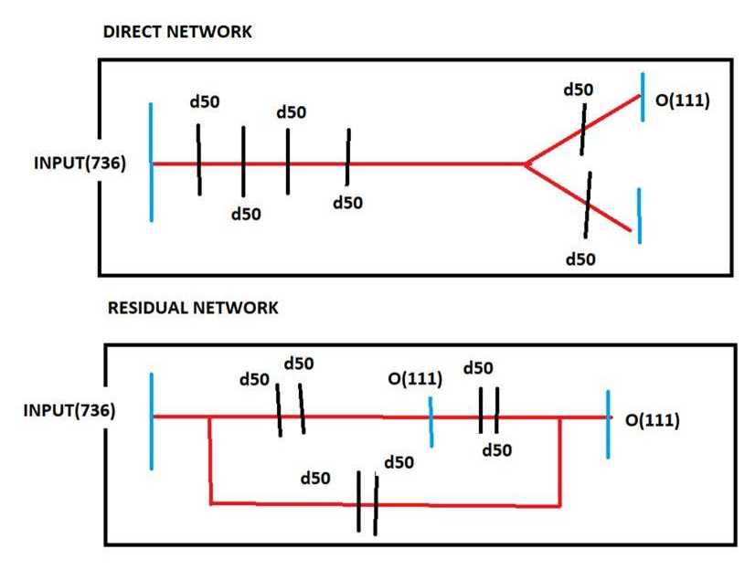
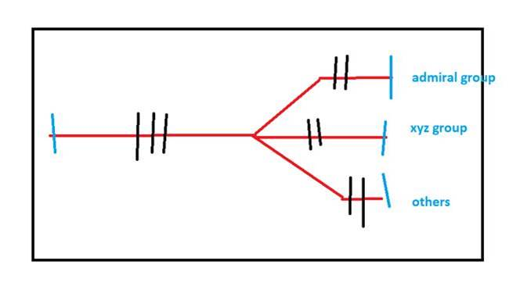
Architectures Explored
Discussion of the prediction surface and residuals surface
Notes:
Originally we built out a simple(ish) model fed by generators to match the top left architecture. We used Keras’ Functional API to build this out. The advantage here is that each output can learn independently but we don’t need to build two separate models.
One other option we considered is the residual network seen below – this model is potentially overkill in this case but should help with information bottlenecks and vanishing gradients. It also would allow us to predict a premium with the knowledge of the already predicted quote/no quote which could improve our accuracy.
One further architecture that we are likely to explore is the one seen on the right where we group outputs by insurance group e.g. all Admiral group’s child companies grouped into one output. This would differ from our current approach which models all brands equally
Because the premiums and quote/no quote probability follows a similar pattern within a group, this could help improve our accuracy by introducing some specificity without generating loads of models
Nice halfway house between one model per insurer and the branched network we originally worked on
Future modelling
The current system assumes the records are independent of each other in space and time
We could use CNNs or perhaps RNNs to model the signals as blocks at a time i.e. feed in blocks of 10 Admiral quotes in time-order.
Add more parameters to the network until it overfits quickly
Then add more regularisation to the model via dropout and L2
Rinse, repeat until you have as many parameters as possible with a model which doesn’t overfit
Magic won’t happen, significant improvements won’t be forthcoming without paradigmatic changes in the model i.e. the CNN idea
Describe this workflow;
ANITA: I’m not too sure what Tim is saying here. Feel free to discuss this, or drop it
General discussion around “Why have one big model vs many small ones” “Isn’t it a bit shit that our model is predicting zero premiums all the time i.e. it’s sparse?” Discuss the vision of an end-to-end prediction architecture with minimal glue code, “software 2.0” google Andrej Kaparthy

Slide 54



Computer Vision
How do convolutional neural networks work?
Notes:
The clever thing about

Slide 55

PREPARE DATASET OF IMAGES

Slide 56

Convolution Filter

Slide 57


Convolution Filter Match

Slide 58


Convolution Filter No Match
MULTIPLY AND SUMMATION = 0

Slide 59



Convolution

Slide 60


Slide 61

Pooling

Slide 62



Winning Architectures
VGGNet, Oxford Uni, 2014
GoogLeNet, Google, 2015
ResNet, Microsoft, 2016
Notes:
Interesting to see the evolution of architectures over time. Generally speaking, the number of layers has increased as time has gone on. Microsoft introduced ResNet in 2016 which won the competition and it had this weird thing with a bypass going through an identity function after every 2 layers, meaning that many of the layers were not doing all that much but it still worked incredibly well!
62

Slide 63

IMAGE CLASSIFICATION EXAMPLE
Notes:
Talk about images being statistically undescriptive
63

Slide 64

Taigman et al. CVPR 2014
DEEP FACE
Alignment
CNN
Metric Learning

Slide 65

VISUALISING THE FILTERS

Slide 66

DEEP VISUALISATION TOOLBOX
https://www.youtube.com/watch?v=AgkfIQ4IGaM

Slide 67
Computer Vision
Demo of CNNs in Data Bricks/Keras
Notes:
The clever thing about

Slide 68

WHAT IS A SEQUENCE?
Notes:
A sequence is any data which has a local or global ordering, which is to say there are time-dependencies between the examples.
If you shuffled the order of such a time-series, its meaning would be lost.
Time series data still often maintains its local or global dependencies even if you discretise the series into aggregate bins of averages.
As a follow-on from that; Micro-scale vs macro-scale analysis is a common thing to deal with when dealing with time-series data.
One of the great things about dealing with sequence data in deep learning as opposed to, say traditional time series is that you can build models which allow many features at once and learn many more parameters about your input data although on the flip side deep learning is far more likely to overfit your data.

Slide 69
What is sequence processing
RNNs
Timeseries classification
Anomaly detection in timeseries
Entity recognition
Revenue forecasting
Question + Answer
1d Convnets
Spelling correction
Document classification
Machine translation

Slide 70
What is sequence processing
RNNs
When global order matters
1d Convnets
Speed
Local temporal dependencies
You can stack them!
Notes:
if global order matters in your sequence data, then it is preferable to use a recurrent network to process it. This is typically the case for timeseries, where the recent past is likely to be more informative than the distant past. But if global ordering isn’t fundamentally meaningful, then 1D convnets will turn out to work at least as well, while being cheaper. This is often the case for text data, where a keyword found at the beginning of a sentence is just as meaningful as a keyword found at the end.

Slide 71


Tokenization
Words
Characters
N-grams
N-Grams example
Notes:
[FREE] Introduce tokenisation
Vectorizing text is the process of transforming text into numeric arrays. This can be done in multiple ways:
By segmenting text into words, and transforming each word into a vector. [as diagram]
By segmenting text into characters, and transforming each character into a vector.
By extracting "N-grams" of words or characters, and transforming each N-gram into a vector. "N-grams" are overlapping groups of multiple consecutive words or characters.
The image on the right side shows the tokenisation of words into 3-dimensional vector representations.
N-grams are shown below, in old school machine learning we needed to design features to transform data outside of the time or space domain because they capture the context around a word. Now that we have RNNs and 1DCNNs, we are no longer forced to use N-grams in deep learning.
ML algorithms don’t understand words
The first thing we do in NLP is transform the text into numbers!
none of the deep learning models you see truly "understands" text in a human sense, rather, these models are able to map the statistical structure of written language, which is sufficient to solve many simple textual tasks.

Slide 72

WORD VECTORS VS word embeddings?
Notes:
There are two ways to obtain word embeddings:
Learn word embeddings jointly with the main task you care about (e.g. document classification or sentiment prediction. In Keras for example you can do this with an Embedding layer.
Load into your model word embeddings that were pre-computed using a different machine learning task than the one you are trying to solve. These are called "pre-trained word embeddings".
While the vectors obtained through one-hot encoding are binary, sparse (mostly made of zeros) and very high-dimensional (same dimensionality as the number of words in the vocabulary), "word embeddings" are low-dimensional floating point vectors (i.e. "dense" vectors, as opposed to sparse vectors). Unlike word vectors obtained via one-hot encoding, word embeddings are learned from data. It is common to see word embeddings that are 256-dimensional, 512-dimensional, or 1024-dimensional when dealing with very large vocabularies. On the other hand, one-hot encoding words generally leads to vectors that are 20,000-dimensional or higher (capturing a vocabulary of 20,000 token in this case). So, word embeddings pack more information into far fewer dimensions.

Slide 73

word embeddings
Word2Vec
GloVe
Notes:
* The geometric relationships between word vectors should reflect the semantic relationships between these words.
Word embeddings are meant to map human language into a geometric space.
With the vector representations we chose here, some semantic relationships between these words can be encoded as geometric transformations. For instance, a same vector allows you to go from "cat" to "tiger" and from "dog" to "wolf": this vector could be interpreted as the "from pet to wild animal" vector. Similarly, another vector allows to go from "dog" to "cat" and from "wolf" to "tiger", which could be interpreted as a "from canine to feline" vector.
In real-world word embedding spaces, common examples of meaningful geometric transformations are "gender vectors" and "plural vector".
For instance, by adding a "female vector" to the vector "king", you get the vector "queen".
The idea of a dense, low-dimensional embedding space for words, computed in an unsupervised way, is quite an old idea; from the early 2000s, but it only started really taking off in research and industry applications after the release of one of the most famous and successful word embedding scheme: the Word2Vec algorithm, developed by Mikolov at Google in 2013. Word2Vec dimensions capture specific semantic properties, e.g. gender. Word2Vec is a shallow, two-layer neural networks that was trained to reconstruct linguistic contexts of words. Word2vec takes as its input a large corpus of text and produces a vector space, typically of several hundred dimensions, with each unique word in the corpus being assigned a corresponding vector in the space.
Another popular one is called "GloVe", developed by Stanford researchers in 2014. It stands for "Global Vectors for Word Representation", and it is an embedding technique based on factorizing a matrix of word co-occurrences

Slide 74

RECURRENT NEURAL NETWORKS
Notes:
Explain the diagram;
The simple RNN isn’t the only recurrent layer available: there are two more, LSTM and GRU . In practice, you will always be using one of these two, as The simple RNN is generally too simplistic to be of any real use.
It has a major issue: albeit it should theoretically be able to retain information about inputs seen many timesteps before, in practice such long-term dependencies are almost impossible to learn. This is due to the "vanishing gradient problem", an effect that is similar to what can be observed with feed forward networks that are many layers deep: as you keep adding layers to a network, the network eventually becomes un-trainable.
on dense networks; We use the relu activation function to help solve this problem, which is particularly bad with the sigmoid and hyperbolic tangent activation functions.

Slide 75

RECURRENT NEURAL NETWORKS
Image © Francois Chollet
Notes:
The word recurrent causes confusion, this is still a directed acyclic graph, there are no cycles in the graph
What does LSTM stand for?
There are lots of explanations of LSTM on the internet, but many of them are very complicated. I have used the explanation from Francois Challet’s book Deep Learning with Python.

Slide 76

LSTMs(1)
Image © Francois Chollet
Notes:
Add a carry track
*

Slide 77

LSTMs(2)

Slide 78



LSTMs(3)
Image © Francois Chollet
Notes:
we can start interpreting what each of these operations are supposed to be doing. For instance, one might say that multiplying c_t with f_t is a way to deliberately "forget" some irrelevant information in the carry dataflow. Meanwhile i_t and k_t provide information about the present, updating the carry track with new information. However, at the end of the day, these interpretations may not mean much, because what these operations actually do is determined by contents of the weights parametrizing them, and the weights are learned in an end-to-end fashion,

Slide 79

LSTM vs GRU
GRU
LSTM
Notes:
There is also another new and popular RNN unit, called the GRU (the gated recurrent unit). It is similar to the LSTM and created much more recently, in 2014. The LSTM was invented in the late 90s.
The key difference between a GRU and an LSTM is that a GRU has two gates (reset and update) whereas an LSTM has three gates ( input, output and forget ).
The GRU unit controls the flow of information just like the LSTM, but without having to use a memory. It just exposes the full hidden content without any control.
GRU is relatively new, the performance is on par with LSTM in certain situations, but computationally much more efficient (because it has a less complex structure). So we are seeing it being used more and more.
LSTMs should in theory remember longer sequences than GRUs and outperform them in tasks requiring modeling long-distance dependencies.

Slide 80

BI-Directional LSTMs

Slide 81

1D-CNNs
Notes:
How does convolution work?
Show MATLAB stuff on convolution

Slide 82
Low Level Features
Mid Level Features
High Level Features
2DCNNS – SAME CONCEPT

Slide 83

STACKING IS COOL

Slide 84
Computer Vision
Demo of RNNs in Data Bricks/Keras
Notes:
The clever thing about

Slide 85
Francois Chollet is a living legend, please buy his book
https://www.manning.com/books/deep-learning-with-python
Notes:
Not a single mathematical formula
Francois is one of the best guys in the community right now
Show book

Slide 86
THANK YOU!
Tim Scarfe
@ecsquendor
youtube.com/machinelearningatmicrosoft

